Slide 1
Facilitator prep
Notes:
Breakout activity 1: Organizational barriers to collaboration
Do
Set up enough breakout rooms to ensure there are max 3-4 participants per group (e.g. 45 participants, set up 12 breakout rooms)
10 min
Assign random breakout groups
Breakout activity 2: Developing collaboration
Do
Set up at least 6 breakout rooms to ensure there are max 3-4 participants per group (e.g. 45 participants, set up 12 breakout rooms)
25 min
Name each breakout room with one of the following:
Work well with other people
Value diversity and inclusivity of others
Manage difficult interactions with other people
Facilitate an environment where you can collaborate with others
Achieve a common goal with others
Reflect and improve on teamwork
When it’s time to launch the activity, auto-assign 3-4 people per room

Slide 2
Activating collaboration
In the chat, feel free to share a little about yourself:
  Your name
  Where you’re joining from
  Your industry & role
  Why your organization needs collaboration
Notes:
I4PL HOST
Welcome participants pre-session
DO
Open the session 10 min in advance
Greet participants as they join
Invite them to respond to the prompts on the slide
At the scheduled start time, introduce the facilitators
Note: no slide needed with their pictures, bios, etc. as they are in the session

Slide 3
Activating collaboration
Skills for Success
for Learning Professionals
Notes:
FACILITATOR(s)
Welcome and introduction 1 min
Do
Introduce yourself (and co-facilitator if applicable)
Let audience know you are facilitating on behalf of I4PL who has been engaged as a partner with ESDC and the Government of Canada to conduct research and provide tools for activating the Skills for Success… more info to come shortly
Transition to FACILITATOR 2
Let’s get started with a little activity to get ourselves into the mindset

Slide 4
Collaboration
Chat
  Do you consider yourself to be collaborative?
  What do you consider your biggest barriers to being collaborative?
Notes:
FACILITATOR 2
Chat: collaboration 2 min
Do
Provide instructions
Ask participants to put their responses into the chat
Transition
Try to remember that feeling as we move through our time together…
On that note, let’s take a look at our objectives for this workshop

Slide 5

Objectives for today
Upon completion of this workshop you will be able to:
  Describe how collaboration can benefit your teams, managers, leaders and organization
  Identify organizational barriers to collaboration
  Discuss organizational structures required to support collaboration
  Identify approaches for development at various levels
  Identify key resources to support your implementation plan
p 2
Notes:
FACILITATOR 2
Objectives 1 min
Do
Walk through objectives
Point out it’s meant to be very interactive and action-focused
Today is not just about learning, but also about enabling them to walk away with a very good start on the business case and an implementation plan for their organization
Transition
And our agenda…

Slide 6
Agenda for today
  About the Skills for Success
  About collaboration
    According to ESDC
    In the research
    In organizations
  Strategies for increasing collaboration
  Additional resources
  Issuing badges
  Wrap up & close
p 2
Notes:
FACILITATOR 2
Agenda 1 min
Do
Walk through agenda
Point out the session is likely to last up to 4 hrs
We will have a 15 min break at around 90 min

Slide 7
How we’ll work together
  Cameras on or off?
  Asking questions and sharing insights
  Use of digital devices
  Respecting each other
  Confidentiality
Notes:
FACILITATOR 2
Agreements for working together 2 min
Do
Ask for preferences of how to communicate, e.g. chat, microphone, hands raised, cameras on, etc?
Transition
Let’s quickly review what Skills for Success is all about

Slide 8
About skills for success
Notes:
FACILITATOR 2
About Skills for Success

Slide 9
About Skills for Success
The Government of Canada has identified a framework of critical Skills for Success that are:
  The skills needed to participate and thrive in learning, work and life
  For everyone – employers, workers, training providers, governments, and communities.
p 4
Notes:
FACILITATOR 2
About Skills for Success 2 min
Say
Skills for Success are the skills needed to participate and thrive in learning, work and life.
The framework includes skills that are foundational for building other skills and knowledge and important for effective social interaction.
These skills overlap and interact with each other, and with other technical and life skills. They are inclusive and can be adapted to different contexts.
The Skills are:
Creativity & innovation
Problem solving
Reading
Digital
Collaboration
Adaptability
Writing
Numeracy, and
Communication
They are for everyone – employers, workers, training providers, governments, and communities.
There is an expectation that workers come to the job market with these skills developed, but that’s not the case
So we need your help to build these essential skills within your organizations

Slide 10
About Skills for Success
The SFS Program:
  Helps Canadians access online tools to assess their skills needs, and
  Funds skills development projects, including assessment and training tools
p 4
Notes:
FACILITATOR 2
About Skills for Success 1 min
DO
Walk through the points on the slide

Slide 11
About I4PL’s role in the initiative
The purpose of I4PL is to elevate the performance of the Canadian workforce.
I4PL partnered with ESDC to:
  Conduct an extensive research project around three of the skills:
    Adaptability
    Collaboration, and
    Creativity & Innovation
  Develop workshops to enable L&D professionals to build Skills for Success in the workplace.
p 5
Notes:
FACILITATOR 2
Role of I4PL 1 min
Say
The purpose of I4PL is to elevate the performance of the Canadian workforce.
I4PL partnered with ESDC to conduct an extensive research project around three of the skills:
Adaptability
Collaboration, and
Creativity & Innovation
As part of this project, the team:
Conducted a systematic review of the research and professional literature on effective practices for building Skills for Success to identify approaches that work for teaching collaboration, collaboration, creativity and innovation, and ones that don’t.
Surveyed L&D professionals to find out the extent to which they are already offering training on the Skills for Success, as well as other commitments and constraints that may affect professionals’ ability to offer more learning in this area.
And based on these findings, we have developed these workshops to help you build Skills for Success in the Canadian workforce.
Transition to FACILITATOR 1
In this workshop we’re going to be focusing on Collaboration
Let’s begin by exploring collaboration as defined by ESDC and the Skills for Success framework

Slide 12
About
Collaboration
Notes:
FACILITATOR 1

Slide 13
Collaboration in the research
Collaboration…
  Affected by individuals, and team and organizational structure, hence must be addressed at all levels
  Important to ease barriers to collaboration, such as access to information, foster interpersonal trust, create clear shared goals, define clear outcomes and structures
p 7
Notes:
FACILITATOR 1
Collaboration in the research 1 min
Do
Walk through the points
Transition to ESDC definition

Slide 14
Collaboration
Your ability to contribute and support others to achieve a common goal.
p 8
Notes:
FACILITATOR 1
Defining Collaboration 1 min
SAY
You’ll find these definitions in your participant materials as well as many SFS resources
Collaboration is defined as the ability to contribute and support others to achieve a common goal.

Slide 15
Collaboration
Work well with other people
Your ability to contribute and support others to achieve a common goal.
Reflect and improve on teamwork
Value diversity and inclusivity of others
Achieve a common goal with others
Manage difficult interactions with other people
Facilitate an environment where you can collaborate with others
p 8
Notes:
FACILITATOR 1
Collaboration components 1 min
Say
A series of “components “make up the collaboration skill – meaning if someone can do these things, they are probably being collaborative.
The components of collaboration are not necessarily sequential… they are:
[click] Work well with other people
[click] Value diversity and inclusivity of others
[click] Manage difficult interactions with other people
[click] Facilitate an environment where you can collaborate with others
[click] Achieve a common goal with others
[click] Reflect and improve on teamwork
These components can help organizations to create:
Assessments to identify gaps and needs, as well as
Learning and development solutions to close those gaps
Transition
Each of these components is further broken down into further observable behaviours

Slide 16
Collaboration
Work well with other people
Value diversity and inclusivity of others
Manage difficult interactions with other people
Facilitate an environment where you can collaborate with others
Achieve a common goal with others
Reflect and improve on teamwork
  Engage in trust building behaviours
  Adhere to social and organizational rules. For example: be on time
  Encourage supportive and cooperative behaviours, language, attitudes, and approaches
  Assess strengths and weaknesses of yourself and others
  Understand that people from different cultures, backgrounds, and abilities can have different customs, values, and ways of thinking and acting
  Acknowledge and accept differences among people
  Respond without judging
  Adapt to different styles of interaction when possible and appropriate
  Engage in productive discussions
  Anticipate and address interpersonal barriers
  Discuss, negotiate, and resolve difficult interactions in a sensitive and helpful manner
  Acknowledge roles of yourself and others
  Understand and adapt to needs, strengths, and weaknesses of others
  Support others through:
    coaching
    mentoring, and
    motivating
  Take responsibility to make contributions and complete tasks
  Consult and share with others when needed and appropriate
  Ensure opportunities for others to contribute
  Assess and mitigate risks and manage resources. For example: via system thinking
  Reflect on team performance
  Make constructive suggestions for improvement
  Use feedback constructively
p 9
Notes:
FACILITATOR 1
Collaboration components 3 min
DO
[click] to reveal each of the expanded definitions in turn
Transition to proficiency levels
The government has also identified proficiency levels
https://www.canada.ca/en/services/jobs/training/initiatives/skills-success/learning-steps.html#collaboration

Slide 17
Collaboration proficiency levels
Proficiency levels are the level at which a person demonstrates a particular skill.
Entry level
  You can interact with familiar people or a small number of diverse unfamiliar people to share information to complete routine independent tasks.
  You can maintain cooperative respectful behaviours toward others and minimize conflict.
Intermediate level
  You can work with familiar and diverse unfamiliar groups of people to coordinate tasks or work together to achieve simple or well-defined goals.
  You can support and adapt to others when appropriate and manage conflicts when needed.
Advanced level
  You can work in large teams of diverse people to achieve complex goals that might involve unpredictable situations.
  You can take on responsibility for:
    integrating work
    coaching and motivating others
    managing conflicts, and
    evaluating and improving teamwork
p 10
Notes:
FACILITATOR 1
Collaboration proficiency levels 3 min
Say
Proficiency levels are the level at which a person demonstrates a particular skill. These levels support organizations to:
build tools to assess people’s skills
help individuals understand their skill levels
[click] to reveal and walk through each of the 3 levels highlighting the differences
[click] Entry level: follow direction, resources provided, under minor stress
[click] Intermediate level: can adjust and complete things with some supervision, some resources provided, under moderate stress
[click] Advanced level: can adjust independently, more self-directed, under high stress
Organizations can adapt the content as needed. The SFS Program will refine the proficiency levels over time.
Transition
What does that mean in the real world?
https://www.canada.ca/en/services/jobs/training/initiatives/skills-success/learning-steps.html#collaboration

Slide 18
Types of team work
People work together in an act of creation
The result is impacted by all contributors
Collaboration
Complex
Cooperation
People co-operate to perform their portion of a shared task
Coordination
Complicated
People co-ordinate distinct efforts to create efficiency
Simple
p 11
Notes:
FACILITATOR 1
Types of team work 2 min
Points
[click] Coordination is the orchestrated efforts of individuals or groups to align or synchronize separate actions. They exchange relevant information and resources in support of each other’s distinct goals. In other words, people coordinate (align/sync) distinct efforts (such as IT upgrading computers and facilities changing out desks) to create more efficiency, but they remain independent.
[click] Cooperation is the coordinated efforts of a group of two or more people to perform their assigned portion of an agreed-upon shared process or task. They are dependent on each other to execute a mutual objective. People co-operate to perform their portion of a shared task as planned. For example, IT works with Finance and Shipping to purchase and deliver new computers on time.
[click] Collaboration is the mutual engagement of a group of two or more in a co-creative effort that achieves a shared goal or vision. They are interdependent, with each unique contribution essential to the whole. People co-labor in an act of creation, and the input of all the contributors changes the result. An example would be several people and departments working together to shift an organization’s culture.
https://www.hrdconnect.com/2023/11/14/differentiating-teamwork-types/

Slide 19
When collaboration is needed
Word Cloud
Thinking about your organization and your team:
  What are some situations where collaboration might be beneficial?
  What level of collaboration is needed?
p 11
Notes:
FACILITATOR 1
Discussion or Word cloud: collaboration needed in your org 10 min
Say
Before we started today, we asked you to think about what’s going on in your organization to identify some situations where collaboration might be needed
Do
Give participants 3 minutes quiet time to reflect on the situations where collaboration is needed in their orgs and encourage them to capture ideas in the word cloud
DO NOT start reading the responses until they have had a few minutes quiet time (cognitive capacity!!)
After 3-5 min, summarize using the next slide

Slide 20
How collaboration benefits…
Individuals
Skill development
Teams
Managers and leaders
Better decision-making
Organization
Increased creativity & innovation
Stronger relationships
Greater creativity & innovation
Improved communication
Better team performance
Opportunity to be coach and leader
Greater delegation &trust
Increased productivity & efficiency
Reduced costs
Better public image
Increased efficiency
Better problem-solving
Better workplace relationships
Greater job satisfaction
Improved career opportunities
Less conflict
Higher engagement
Lower resistance
Higher adaptability & agility
Higher engagement & retention
Enhanced customer experience
p 13
Notes:
FACILITATOR 2
Lead discussion 15 min
Do
[click] to reveal each category in turn
Ask participants to share ONE benefit for that category
[click] to fill in any gaps the group has not already mentioned
Transition to responsibility for collaboration
We know that everyone benefits from collaboration, and that everyone needs to BE collaborative…
But the research and the real world tell us nobody has really taken ownership for helping individuals develop this critical skill.
Employers assume candidates and employees will come armed with it, but it’s not a skill that is being developed from childhood, in school or in higher education

Slide 21
Supporting
Collaboration
Notes:
FACILITATOR 2
IN THE BACKGROUND
FACILITATOR 1 PREPARE Breakout activity 1: Organizational barriers to collaboration
Do
Set up enough breakout rooms to ensure there are max 3-4 participants per group (e.g. 45 participants, set up 12 breakout rooms)
10 min
Assign random breakout groups

Slide 22
Responsibility for collaboration
Organization
Leadership
Manager
Team
Individual
Notes:
FACILITATOR 2
Responsibility for collaboration 1 min
say
ALL of these are responsible for it… but this is where it gets really interesting,
Because the research tells us there is almost NOTHING happening at the individual level…
Heavy focus on organizational culture, processes, and structures to support collaboration
Many options for managers and leaders to coach for collaboration
There are few, if any, tips on how to teach collaboration at the individual level
So this is where we’re going to focus our time today – exploring how to activate collaboration in individuals
It’s going to be a bit like Russian dolls… with the individual at the centre
Transition
Let’s dig a little deeper into each of the levels…
Starting at the organizational level

Slide 23
Organizational barriers to collaboration
Breakout Activity (10 min)
Think about the collaboration needed at your organization…
  What organizational structures get in the way?
  How could you overcome these barriers?
p 15
Notes:
FACILITATOR 2
BREAKOUT DISCUSSION: Organizational barriers to collaboration 20 min
10 min breakout + 10 min plenary discussion
Say
We know that the culture and the ecosystem of an organization are critically important to supporting collaboration
We’ll talk about leaders and managers in a few minutes, but what are some of the things that get in the way at an organizational level?
Do
Provide instructions for discussion
Remind them to think specifically about what is needed at their organization (pre-work)
Ask participants to consider org structures, processes, etc.
Take any questions
Launch random breakout groups of max 3 participants per room
Give 10 minutes to conduct activity
Transition to FACILITATOR 1 to debrief
do
After 10 min, bring them back and call on a few participants to share
Encourage participants to capture reflections in their materials
Responses should include things like:
Steep and deep hierarchies
Complex or complicated procedures or processes
Layers of approvals
Reward and recognition policies
Goal-setting and performance management policies (or lack thereof)
Transition
It will be important as you develop your business case and implementation plan to identify some specific strategies to overcome the barriers to collaboration and any other Skills for Success
Let’s now talk about Leaders and collaboration

Slide 24
How leaders support collaboration
Discussion
What skills do leaders need to support Collaboration?
Work well with other people
Value diversity and inclusivity of others
Manage difficult interactions with other people
Facilitate an environment where you can collaborate with others
Achieve a common goal with others
Reflect and improve on teamwork
p 15
Notes:
FACILITATOR 1
Discussion or Word cloud: how LEADERS support collaboration 5 min
Say
We know leaders and managers play a very important role in supporting collaboration
If we check back into the components of collaboration, what are some of the things LEADERS need to be able to do to support collaboration in workforce?
Do
Give participants 3 minutes quiet time to capture ideas in the word cloud
DO NOT start reading the responses until they have had a few minutes quiet time (cognitive capacity!!)
After 3-5 min, summarize using the next slide

Slide 25
What skills do leaders need to support Collaboration?
Work well with other people
Value diversity and inclusivity of others
Manage difficult interactions with other people
Facilitate an environment where you can collaborate with others
Achieve a common goal with others
Reflect and improve on teamwork
Some examples include:
  Lead by example
  Promote and reward teamwork
  Facilitate cross-functional collaboration
  Align reward and talent strategies
p 16
Notes:
FACILITATOR 1
Debrief how leaders support collaboration 5 min
Do
Fill in any gaps with the points on the slide
Encourage participants to capture additional suggestions or insights sparked by the discussion
Feel free to add suggestions for the next workshop too!
Transition to FACILITATOR 2
Managers also play a very important role in supporting collaboration

Slide 26
How managers support collaboration
Discussion
What additional skills do managers need?
Work well with other people
Value diversity and inclusivity of others
Manage difficult interactions with other people
Facilitate an environment where you can collaborate with others
Achieve a common goal with others
Reflect and improve on teamwork
p 15
Notes:
FACILITATOR 2
Discussion or Word cloud: how MANAGERS support collaboration 5 min
Say
Managers need a lot of the same skills and behaviours we just explored for leaders…
Is there anything else they need to support collaboration?
Do
Give participants 3 minutes quiet time to capture ideas in the word cloud
DO NOT start reading the responses until they have had a few minutes quiet time (cognitive capacity!!)
After 3-5 min, summarize using the next slide

Slide 27
What additional skills do managers need?
Work well with other people
Value diversity and inclusivity of others
Manage difficult interactions with other people
Facilitate an environment where you can collaborate with others
Achieve a common goal with others
Reflect and improve on teamwork
Similar to leaders plus:
  Build common goals
  Set and refine goals together
  Link goals and tasks to strategy
  Protect time to collaborate
  Delegate and empower
  Role-model optimal inclusion
p 16
Notes:
FACILITATOR 2
Debrief how managers support collaboration 5 min
Do
As we saw for leaders, many suggestions are common or hot topics and there is no shortage of solutions that can help with implementation
Fill in any gaps with the points on the slide
Encourage participants to capture additional suggestions or insights sparked by the discussion
Feel free to add suggestions for the next workshop too!
Transition to 15 min break
Say
When we come back, we’re going to hone in on development of collaboration in individuals

Slide 28
break
15 min
Notes:
DURING BREAK SET UP Breakout activity 2: Developing collaboration
Do
Set up at least 6 breakout rooms to ensure there are max 3-4 participants per group (e.g. 45 participants, set up 12 breakout rooms)
25 min
Name each breakout room with one of the following:
Work well with other people
Value diversity and inclusivity of others
Manage difficult interactions with other people
Facilitate an environment where you can collaborate with others
Achieve a common goal with others
Reflect and improve on teamwork
When it’s time to launch the activity, auto-assign 3-4 people per room

Slide 29
Developing
Collaboration
Notes:
FACILITATOR 1
Do
Welcome learners back

Slide 30
Collaboration in the research: individuals and teams
  Mix of individual and team development, supported by managers, leaders, structures, etc.
  Each person/role has its own skills, resources, priorities, and bosses that may conflict with each other
  (Ashkenas, 2015)
  Critical ingredients include:
    Trust
    Relationship building
    Conflict management
p 18
Notes:
FACILITATOR 1
Collaboration in the research 2 min
Points
Collaboration can be explained as a combination of personality, competencies developed from life experiences, and behaviours to engage in planning, exploring and decision-making
Some research showed that error-avoidant personalities can become more collaborative when encouraged to embrace mastery over performance
Organizations support collaboration with an emphasis on psychological safety, and
Building a culture that allows for errors, with feedback and reflection to help with adaptive learning, wherever possible

Slide 31
Collaboration in the research: development
Some things that have been working
  Experiential learning
  Practice and making errors, then using those errors to refine approach
  Speed dating approach
  Cooperative learning
p 18
Notes:
FACILITATOR 1
Collaboration in the research 5 min
Points (in the research article)
Will dig in
Transition to collaboration components
Those are some general studies that showed up around the overall theme of collaboration. Let’s keep those in mind as we dig deeper into the components of collaboration.

Slide 32
Collaboration
Your ability to contribute and support others to achieve a common goal.
Work well with other people
Reflect and improve on teamwork
Value diversity and inclusivity of others
Achieve a common goal with others
Manage difficult interactions with other people
Facilitate an environment where you can collaborate with others
Notes:
FACILITATOR 1
Collaboration components 1 min
Say
Remember the components we talked about. These all work together to help someone be collaborative.
You may find your team members need to focus on one, some or all of these behaviours to enhance their collaboration.
I’d like us to spend the rest of our time together digging down into ways you can build these behaviours to create a more collaborative workforce within your organization.

Slide 33
Developing collaboration in individuals
Breakout (25 min)
Work well with other people
  Each group will be assigned one component
    Refer to the resources and your experience
  Design a specific learning activity you would use to develop individuals or teams, plus
  Identify what other support is needed by :
    Managers
    Leaders
    Organization
  When you come back, we will have 10 min for each component to share ideas
Reflect and improve on teamwork
Value diversity and inclusivity of others
Achieve a common goal with others
Manage difficult interactions with other people
Facilitate an environment where you can collaborate with others
Notes:
FACILITATOR 1
Introduce and conduct breakout activity 25 min
25 min activity + 60 min debrief
Do
Provide the instructions
Let participants know they will have 25 min to work on one component each and they will have 10 min to share their suggestions with the group
There are references in their participant materials, as well as space to capture their thinking
They should consider
Whether the component requires an individual or team intervention, plus
What else is needed by Managers and leaders and the Organization
After 25 min, bring them back and alternate with FACILITATOR 2 to debrief using the next slides

Slide 34
Collaboration
Work well with other people
Trust-building exercises
    Team activities that require trust, opportunity to fail and learn, e.g. trust falls
Strengths Development Interventions
    Individual and team level assessments and programs focused on identifying, developing, and utilizing employees' strengths have been shown to stimulate personal growth initiative and team interactions
  Engage in trust building behaviours
  Adhere to social and organizational rules. For example: be on time
  Encourage supportive and cooperative behaviours, language, attitudes, and approaches
  Assess strengths and weaknesses of yourself and others
19-20
Notes:
FACILITATOR 2
Work well with other people up to 10 min
DO
Call on the group to share their ideas
Encourage others to capture insights
Be sure to challenge them to be specific and consider learners, teams, managers, leaders and organizational interventions needed
[click] to share the additional research/method provided (if not provided by the group, also in their participant materials)
Transition to FACILITATOR 1
Let’s look at the next component
Tbd
https://bpspsychub.onlinelibrary.wiley.com/doi/10.1111/joop.12240

Slide 35
Collaboration
Value diversity and inclusivity of others
Value and leverage diversity
    Individual learning to raise awareness and appreciation of others’ input
Adapt to styles
    Individual style assessments and workshops or coaching to apply the findings
    Team-building activities based on styles to explore ways to adapt, better communicate and leverage strengths
  Understand that people from different cultures, backgrounds, and abilities can have different customs, values, and ways of thinking and acting
  Acknowledge and accept differences among people
  Respond without judging
  Adapt to different styles of interaction when possible and appropriate
21-22
Notes:
FACILITATOR 1
Value diversity and inclusivity of others up to 10 min
DO
Call on the group to share their ideas
Encourage others to capture insights
Be sure to challenge them to be specific and consider learners, teams, managers, leaders and organizational interventions needed
[click] to share the additional research/method provided (if not provided by the group, also in their participant materials)
Transition to FACILITATOR 2
Let’s look at the next component

Slide 36
Collaboration
Manage difficult interactions with other people
Communication and conflict resolution
    Individual approaches to build communication, negotiation and conflict resolution skills
    Targeted or team approaches to effective discussion, debate, and overcoming barriers
  Engage in productive discussions
  Anticipate and address interpersonal barriers
  Discuss, negotiate, and resolve difficult interactions in a sensitive and helpful manner
23-24
Notes:
FACILITATOR 2
Emotion regulation up to 10 min
DO
Call on the group to share their ideas
Encourage others to capture insights
Be sure to challenge them to be specific and consider learners, teams, managers, leaders and organizational interventions needed
[click] to share the additional research/method provided (if not provided by the group, also in their participant materials)
Transition to FACILITATOR 1
Let’s look at the next component

Slide 37
Collaboration
Facilitate an environment where you can collaborate with others
Role clarity
    Individual personal brand and role definition
    Team expectation setting activities, e.g. project kickoff
Supporting others
    Coaching, mentoring and feedback skills
  Acknowledge roles of yourself and others
  Understand and adapt to needs, strengths, and weaknesses of others
  Support others through:
    coaching
    mentoring, and
    motivating
25-26
Notes:
FACILITATOR 1
Goal setting and expectations up to 10 min
DO
Call on the group to share their ideas
Encourage others to capture insights
Be sure to challenge them to be specific and consider learners, teams, managers, leaders and organizational interventions needed
[click] to share the additional research/method provided (if not provided by the group, also in their participant materials)
Transition to FACILITATOR 2
Let’s look at the next component

Slide 38
Collaboration
Achieve a common goal with others
Create common goals
    Team activity to align goal with organization or division strategy
    Solicit input on goal and steps to achieve it
  Take responsibility to make contributions and complete tasks
  Consult and share with others when needed and appropriate
  Ensure opportunities for others to contribute
  Assess and mitigate risks and manage resources. For example: via system thinking
27-28
Notes:
FACILITATOR 2
Achieve a common goal with others up to 10 min
DO
Call on the group to share their ideas
Encourage others to capture insights
Be sure to challenge them to be specific and consider learners, teams, managers, leaders and organizational interventions needed
[click] to share the additional research/method provided (if not provided by the group, also in their participant materials)
Transition to FACILITATOR 1
Let’s look at the next component

Slide 39
Collaboration
Reflect and improve on teamwork
Evaluation and feedback
    Individual development on evaluation, feedback and coaching
    Team lessons learned, do more, do better
  Reflect on team performance
  Make constructive suggestions for improvement
  Use feedback constructively
29-30
Notes:
FACILITATOR 1
Reflect and improve on teamwork up to 10 min
DO
Call on the group to share their ideas
Encourage others to capture insights
Be sure to challenge them to be specific and consider learners, teams, managers, leaders and organizational interventions needed
[click] to share the additional research/method provided (if not provided by the group, also in their participant materials)
Transition to FACILITATOR 2
We’ve provided you with a few resources in your participant materials
Let’s look at a few more resources to support you as you look to implement Skills for Success with your organizations
https://en.wikipedia.org/wiki/Identity_based_motivation
https://bpspsychub.onlinelibrary.wiley.com/doi/10.1111/joop.12240

Slide 40
Skills for success resources
Notes:
FACILITATOR 2

Slide 41
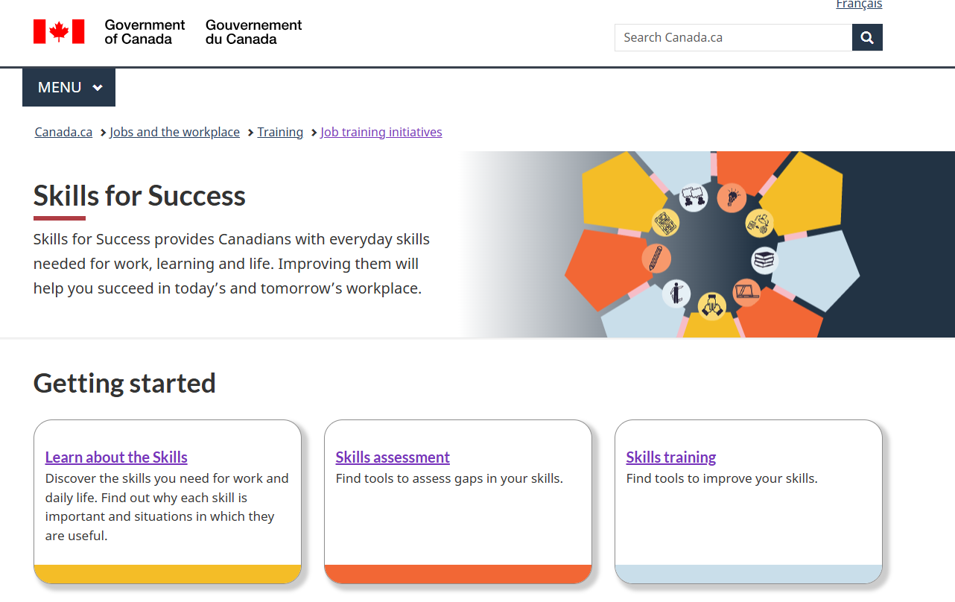
Skills for Success Website
p 32
Notes:
FACILITATOR 2
SFS Resources
Do
Refer participants to the resources on the following slides
Let them know they will find links in their participant materials and the microsite
Official SFS website
say
Here you’ll find links to all of the following tools…
https://www.canada.ca/en/services/jobs/training/initiatives/skills-success.html

Slide 42
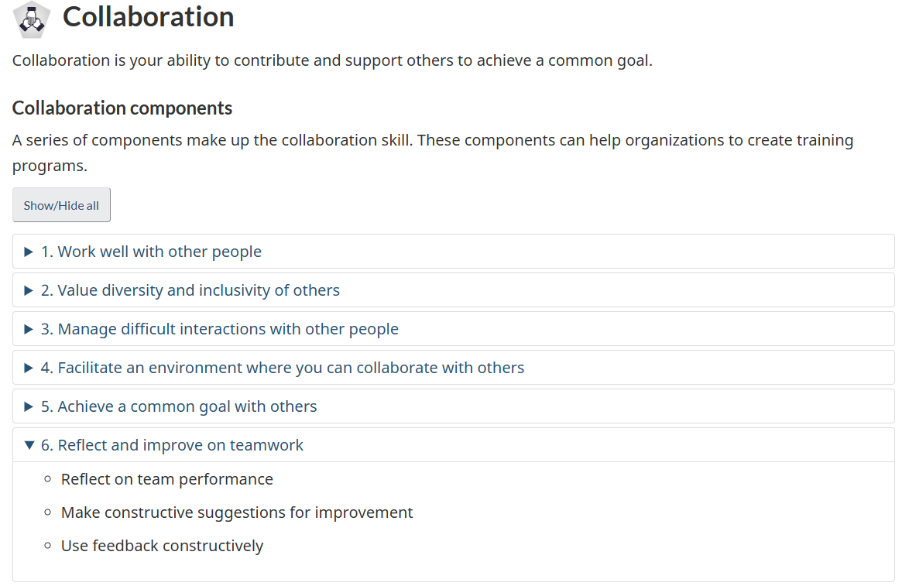
Skills for Success Skills and components
p 32
Notes:
FACILITATOR 2
Official SFS website
say
Here you’ll find the definitions, components and behaviours
https://www.canada.ca/en/services/jobs/training/initiatives/skills-success/learning-steps.html#collaboration

Slide 43
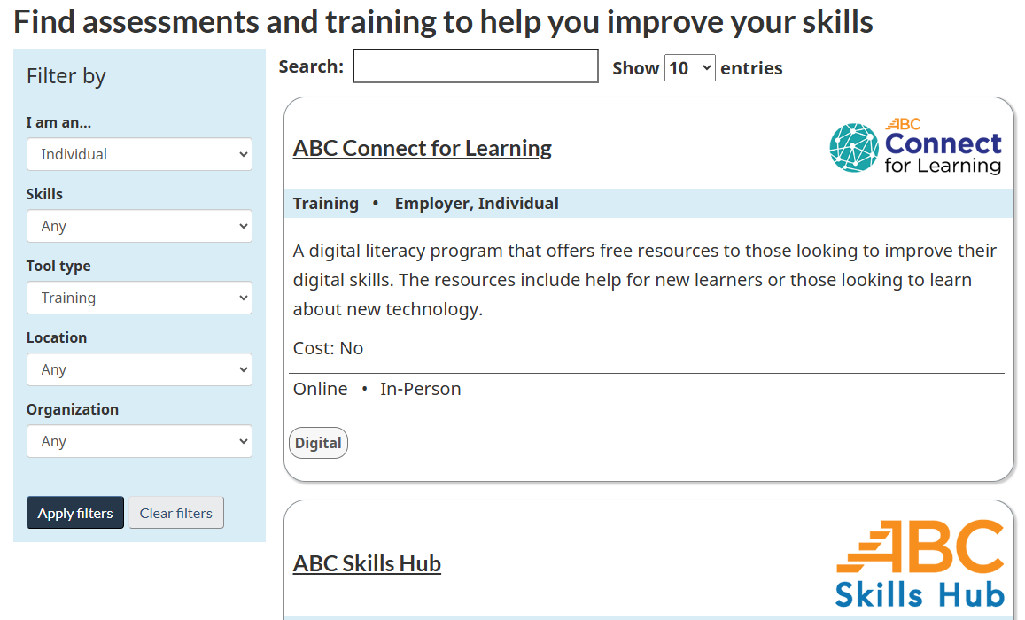
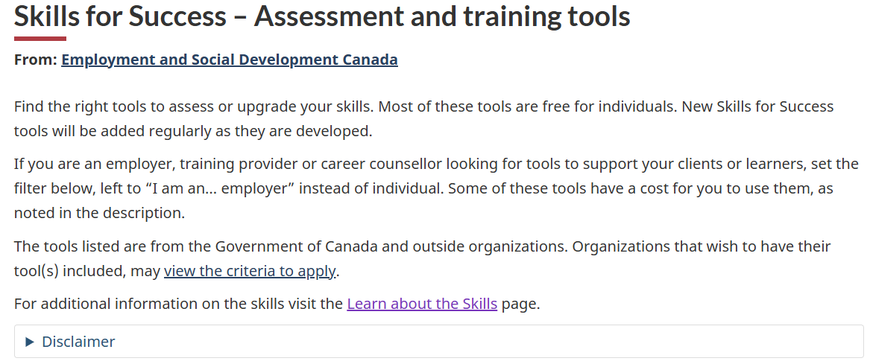
Skills for Success Assessment and training tools
p 32
Notes:
FACILITATOR 2
Official SFS website Assessment and training tools
say
Here is a searchable repository of various assessments, programs and resources approved by ESDC to support development
Includes both free and paid resources
Searchable:
As Individual or Employer
By specific skill or all skills
Training or assessments
Online or in-person, and
By specific organization or provider
https://www.canada.ca/en/services/jobs/training/initiatives/skills-success/tools.html?category=Individual&type=Training

Slide 44

Skills for Success Snapshot
p 32
Notes:
FACILITATOR 2
SFS Snapshot
say
This, for example is a self-assessment you and your learners can use AFTER completing a skill-building program
https://immplus.ca/snapshot/

Slide 45
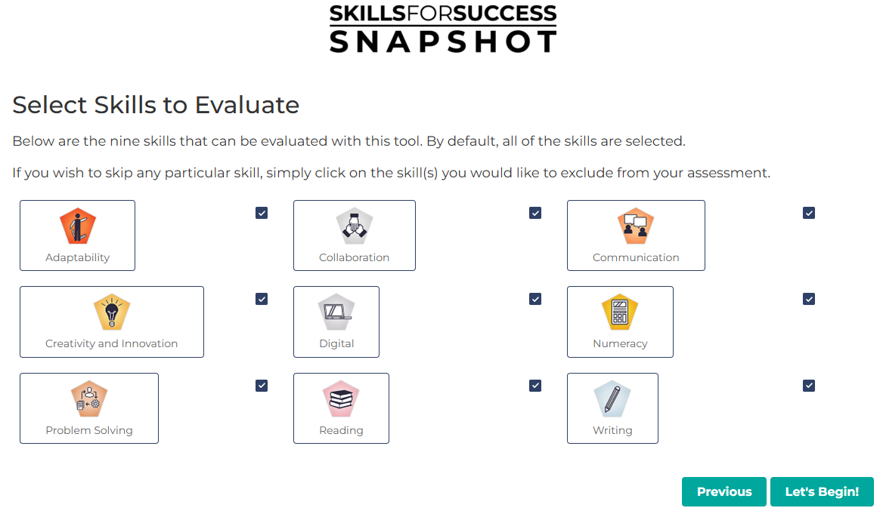
Skills for Success Snapshot
p 32
Notes:
FACILITATOR 2
SFS Snapshot
say
Learners can choose to do any or all of the skills
https://immplus.ca/snapshot/

Slide 46
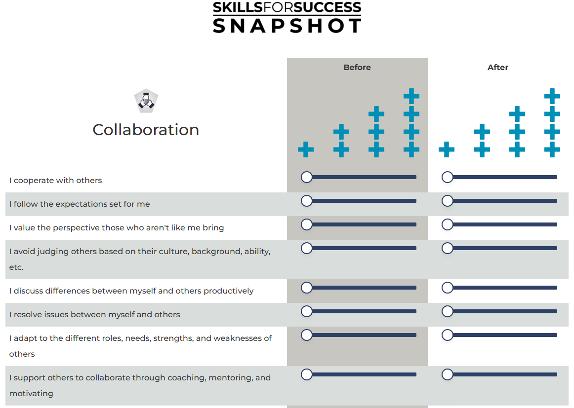
Skills for Success Snapshot
p 32
Notes:
FACILITATOR 2
SFS Snapshot
say
Here is a sneak peek of the Collaboration assessment
Learners rank against their perceived collaboration BEFORE and AFTER the intervention
https://immplus.ca/snapshot/

Slide 47
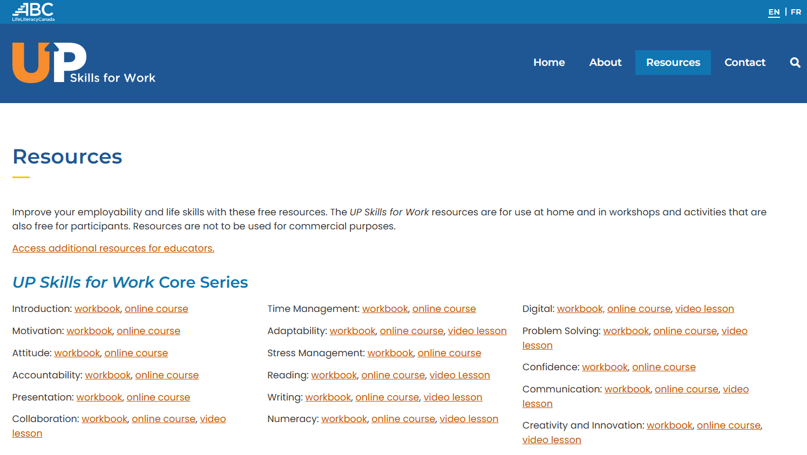
Skills for Success Resources
p 32
Notes:
FACILITATOR 2
UP Skills for Work website
Say
One example of resources available from one of the organizations hosted on the SFS search engine
https://upskillsforwork.ca/resources/
Transition to FACILITATOR 1 to explain about badges

Slide 48

Skills for Success Resources
p 32
Notes:
FACILITATOR 2
I4PL Microsite
Say
This is where you will find the research article as well as the powerpoint versions of this presentation and the workbook for you to use for future programs
/
Transition to FACILITATOR 1 to explain about badges

Slide 49
Skills for success badges
Notes:
FACILITATOR 1
Say
As part of this initiative, you were promised badges distinguishing you as Skills for Success Learning Providers

Slide 50


Two types of badges
For you
For your learners
p 34
Notes:
FACILITATOR 1
Types of badges 1 min
Say
There are two types of badges available
[click] the first is the Learning Provider badge, which you are eligible for
[click] the second is available for you to provide to participants of the programs you provide to increase collaboration
Let’s look more closely at each of them

Slide 51
Learning Provider badge
You can proudly post this badge, and gain 8 continuing education credits for this program.
Two requirements:
  Participation in this workshop
  Completion of a small assignment detailing your implementation plan
p 34
Notes:
FACILITATOR 1
Requirements 1 min
Do
Read through the points on the slide

Slide 52
Submitting your implementation plan
Visit CanCred to provide responses to the following:
  The greatest benefit my organization will enjoy as a result of improved Collaboration is…
  Our most significant organizational barriers to developing Collaboration are…
  The organizational structures we need to address to support Collaboration are…
  My plan for increasing Collaboration in my organization
    PDF file upload
    Be sure to identify approaches for development at various levels
p 34
Notes:
FACILITATOR 1
Submitting your implementation plan 2 min
Do
Read through the points on the slide
Transition to FACILITATOR 2 to discuss the LEARNER badges

Slide 53
Issuing badges to your learners
The programs you implement should ensure learners are able to:
  Articulate the benefits of Collaboration for their team, the organization and themselves
  Identify individual barriers to developing Collaboration
  Determine what is needed to support Collaboration
  Develop strategies for being more collaborative in various situations
p 35
Notes:
FACILITATOR 2
Suggestions for learner programs 2 min
Do
Read through the points on the slide

Slide 54
Issuing badges to your learners
Suggested learning experiences include:
  An interactive workshop which provides:
    Key concepts and applications for the workplace
    Practical activities to apply the concepts in real-life scenarios
    Opportunities to work with others in the development of the skill
  Follow up activities that enable learners to apply the skill with support from their manager
  Submission of a personal action plan
p 35
Notes:
FACILITATOR 2
Suggestions for learner programs 2 min
Do
Read through the points on the slide

Slide 55
Issuing badges to learners
Direct learners to CanCred using the access code: tegmef636hb2
  Learners apply for their badges by providing their name and responses to the following:
    My most significant barriers to developing Collaboration are…
    My #1 strategy for being more collaborative is…
p 35
Notes:
FACILITATOR 2
Learner badge requirements 2 min
Do
Read through the points on the slide
Point out they need to provide the instructions to their learners
Transition to FACILITATOR 1 to lead the closing activity

Slide 56
Closing the day
Notes:
FACILITATOR 1

Slide 57
Committing to Collaboration
Virtual baton
What is one thing you will do differently
after today?
p 36
Notes:
FACILITATOR 1
Lead closing activity 8 min
DO
Explain we will use a virtual baton
You will nominate one person and ask them to share ONE thing they will do differently after today
Then they should nominate someone else, until all participants have shared
You will be last
Remind them to put together their implementation plan and apply for their badges
Transition
Ask for questions and thank participants

Slide 58
Questions?
Thank you from all of us at I4PL
Notes:
FACILITATOR(s)

