Slide 1
Facilitator prep
Notes:
Poll
Do
Create a poll – multiple select
Are you:
Creative
Innovative
None of the above
Breakout activity 1: Organizational barriers to creativity & innovation
Do
Set up enough breakout rooms to ensure there are max 3-4 participants per group (e.g. 45 participants, set up 12 breakout rooms)
10 min
Assign random breakout groups
Breakout activity 2: Developing creativity & innovation
Do
Set up at least 6 breakout rooms to ensure there are max 3-4 participants per group (e.g. 45 participants, set up 12 breakout rooms)
10 min
Name each breakout room with one of the following:
Use your imagination and curiosity
Identify opportunities to innovate
Generate ideas that are novel to yourself or others
Develop your ideas
Apply your ideas
Facilitate a creative & innovative environment
When it’s time to launch the activity, auto-assign 3-4 people per room

Slide 2
Activating creativity & innovation
In the chat, feel free to share a little about yourself:
  Your name
  Where you’re joining from
  Your industry & role
  Why your organization needs creativity & innovation
Notes:
I4PL HOST
Welcome participants pre-session
DO
Open the session 10 min in advance
Greet participants as they join
Invite them to respond to the prompts on the slide
At the scheduled start time, introduce the facilitators
Note: no slide needed with their pictures, bios, etc. as they are in the session

Slide 3
Activating creativity & innovation
Skills for Success
for Learning Professionals
Notes:
FACILITATOR(s)-Beverly
Welcome and introduction 1 min
Do
Introduce yourself (and co-facilitator if applicable)
Let audience know you are facilitating on behalf of I4PL who has been engaged as a partner with ESDC ( Employment and Social Development Canada) a department of the Government of Canada to conduct research and provide tools for activating the Skills for Success… more info to come shortly
Transition to ROBINA
Let’s get started with a little activity to get ourselves into the mindset

Slide 4
Creativity & innovation
Chat
  Do you consider yourself to be creative or innovative?
  What do you consider your biggest barriers to being creative or innovative?
Notes:
ROBINA
Chat: creativity & innovation 2 min
Do
Provide instructions
Ask participants to put their responses into the chat
Transition
Try to remember that feeling as we move through our time together…
On that note, let’s take a look at our objectives for this workshop

Slide 5

Objectives for today
Upon completion of this workshop you will be able to:
  Describe how creativity & innovation can benefit your teams, managers, leaders and organization
  Identify organizational barriers to creativity & innovation
  Discuss organizational structures required to support creativity & innovation
  Identify approaches for development at various levels
  Identify key resources to support your implementation plan
p 2
Notes:
ROBINA
Objectives 1 min
Do
Walk through objectives
Point out it’s meant to be very interactive and action-focused
Today is not just about learning, but also about enabling them to walk away with a very good start on the business case and an implementation plan for their organization
Transition
And our agenda…

Slide 6
Agenda for today
  About the Skills for Success
  About creativity & innovation
    According to ESDC
    In the research
    In organizations
  Strategies for increasing creativity & innovation
  Additional resources
  Issuing badges
  Wrap up & close
p 2
Notes:
ROBINA
Agenda 1 min
Do
Walk through agenda
Point out the session is likely to last up to 4 hrs
We will have a 15 min break at around 90 min

Slide 7
How we’ll work together
  Cameras on or off?
  Asking questions and sharing insights
  Use of digital devices
  Respecting each other
  Confidentiality
Notes:
ROBINA
Agreements for working together 2 min
Do
Ask for preferences of how to communicate, e.g. chat, microphone, hands raised, cameras on, etc?
Transition
Let’s quickly review what Skills for Success is all about

Slide 8
About skills for success
Notes:
ROBINA
About Skills for Success

Slide 9
About Skills for Success
The Government of Canada has identified a framework of critical Skills for Success that are:
  The skills needed to participate and thrive in learning, work and life
  For everyone – employers, workers, training providers, governments, and communities.
p 4
Notes:
ROBINA
About Skills for Success 2 min
Say
Skills for Success are the skills needed to participate and thrive in learning, work and life.
The framework includes skills that are foundational for building other skills and knowledge and important for effective social interaction.
These skills overlap and interact with each other, and with other technical and life skills. They are inclusive and can be adapted to different contexts.
The Skills are:
Creativity & innovation
Problem solving
Reading
Digital
Collaboration
Adaptability
Writing
Numeracy, and
Communication
They are for everyone – employers, workers, training providers, governments, and communities.
There is an expectation that workers come to the job market with these skills developed, but that’s not the case
So we need your help to build these essential skills within your organizations

Slide 10
About Skills for Success
The SFS Program:
  Helps Canadians access online tools to assess their skills needs, and
  Funds skills development projects, including assessment and training tools
p 4
Notes:
ROBINA
About Skills for Success 1 min
DO
Walk through the points on the slide

Slide 11
About I4PL’s role in the initiative
The purpose of I4PL is to elevate the performance of the Canadian workforce.
I4PL partnered with ESDC to:
  Conduct an extensive research project around three of the skills:
    Adaptability
    Collaboration, and
    Creativity & Innovation
  Develop workshops to enable L&D professionals to build Skills for Success in the workplace.
p 5
Notes:
ROBINA
Role of I4PL 1 min
Say
The purpose of I4PL is to elevate the performance of the Canadian workforce.
I4PL partnered with ESDC to conduct an extensive research project around three of the skills:
Adaptability
Collaboration, and
Creativity & Innovation
As part of this project, the team:
Conducted a systematic review of the research and professional literature on effective practices for building Skills for Success to identify approaches that work for teaching collaboration, creativity & innovation, creativity and innovation, and ones that don’t.
Surveyed L&D professionals to find out the extent to which they are already offering training on the Skills for Success, as well as other commitments and constraints that may affect professionals’ ability to offer more learning in this area.
And based on these findings, we have developed these workshops to help you build Skills for Success in the Canadian workforce.
Transition to BEVERLY- click to next slide

Slide 12
About creativity & innovation
Notes:
BEVERLY
In this workshop we’re going to be focusing on creativity & innovation
Let’s begin by exploring creativity & innovation and what it means

Slide 13
Creativity & innovation in the research
  Creativity and innovation are related but also different
  Some articles indicated that creativity is not teachable, but it is coachable
  Performance-oriented individuals less likely to show creativity
  Organizational norms, leadership, structure, and rewards play a role
p 7
Notes:
BEVERLY
creativity & innovation in the research 1 min
Say
Here is a summary of what the research on creativity & innovation identifies
Do
Walk through the points

Slide 14
Creativity
vs
Innovation
p 8
Notes:
BEVERLY
Discussion: definitions 3 min
Say
I would like to hear from about 3 people...raise your hand if you would like to share
Ask
Are creativity and innovation the same thing?
If not, what is the difference?
Do
Take a few responses then
Debrief using next slide

Slide 15
Creativity & innovation in the research: definitions
Creativity
Innovation
  Creativity means generating ideas that are both new and useful, a result of solving challenging problems
  (Leung et al., 2014; Birdi, 2007), (Amabile (1996) in Bjorkman, 2004))
  Creativity can be an individual or socially-influenced experience within a person’s control
  (Birdi, 2007)
  Innovation refers to implementing useful ideas
  (Puccio, 2005)
  Innovation requires social processes of negotiating and influencing to gain the acceptance and resources needed to put ideas into practice
  (Birdi, 2007)
p 8
Notes:
BEVERLY
creativity & innovation in the research 1 min
Say
Thank you for sharing.....Let's look at the definitions for creativity and innovation from the research
Do
[click] to reveal each definition in turn
Walk through the points
Creativity may also include other requirements such as being appropriate to the context, or being valued and accepted by a community (Watson, 2007).
Transition to ESDC definition

Slide 16
Creativity & innovation
Your ability to imagine, develop, express, encourage, and apply ideas in ways that are novel, unexpected, or challenge existing methods and norms.
p 9
Notes:
BEVERLY
Defining creativity & innovation 1 min
SAY
ESDC definition
You’ll find these definitions in your participant materials as well as many SFS resources
Creativity & innovation is defined as your ability to imagine, develop, express, encourage, and apply ideas in ways that are novel, unexpected, or challenge existing methods and norms.
No need to take notes or pictures on this – it’s in your workbooks

Slide 17
Creativity
&
Innovation
Use your imagination and curiosity
Your ability to imagine, develop, express, encourage, and apply ideas in ways that are novel, unexpected, or challenge existing methods and norms.
Facilitate a creative & innovative environment
Identify opportunities to innovate
Apply your ideas
Generate ideas that are novel to yourself or others
Develop your ideas
p 9
Notes:
BEVERLY
Creativity & Innovation components 1 min
Say
A series of “components “make up the creativity & innovation skill – meaning if someone can do these things, they are probably being creative & innovative.
The components of creativity & innovation are not necessarily sequential… they are:
[click] Use your imagination and curiosity
[click] Identify opportunities to innovate
[click] Generate ideas that are novel to yourself or others
[click] Develop your ideas
[click] Apply your ideas
[click] Facilitate a creative & innovative environment
These components can help organizations to create:
Assessments to identify gaps and needs, as well as
Learning and development solutions to close those gaps
Transition
Each of these components is further broken down into observable behaviours

Slide 18
Creativity & innovation
Use your imagination and curiosity
Identify opportunities to innovate
Generate ideas that are novel to yourself or others
Develop your ideas
Apply your ideas
Facilitate a creative & innovative environment
  Imagine different situations and possibilities
  Show interest in learning and applying new things
  Seek a wide range of stimuli and experiences
  Be open to new ideas without judging and setting limitations
  Challenge norms, habits, and preconceptions where appropriate
  Identify artificial constraints
  Deviate from existing processes, thinking, and approaches
  Use an inquisitive approach. For example: ask questions even when there is no obvious answer
  Seek patterns where patterns may not be readily apparent. For example: combine unrelated attributes
  Acknowledge and work with uncertainty and unpredictability.
  Reverse ideas and approaches to see if the opposite is true
  Expand on ideas and approaches
  Act on the creative ideas and approaches to make tangible and useful contributions
  Expect failures
  Learn from failures to improve
  Encourage habits and behaviors that facilitate creativity and innovation in yourself and others, for example:
    lightheartedness
    playful approach
    healthy competition
  Support and motivate others to be creative by coaching and sharing tools, information, and ideas
p 10
Notes:
BEVERLY
Creativity & Innovation components 3 min
DO
[click] to reveal each of the expanded definitions in turn
Let them know you will spend more time with these in depth later in the session
Say
The government has also identified proficiency levels
https://www.canada.ca/en/services/jobs/training/initiatives/skills-success/learning-steps.html#creativity
Time to dive into this more later on in the session

Slide 19
Creativity & innovation proficiency levels
Proficiency levels are the level at which a person demonstrates a particular skill.
Entry level
  You can generate a limited number of novel ideas under guidance and support.
  You are open to applying new ideas, but are quick to revert to norms and habits when the new ideas fail or face uncertainties.
Intermediate level
  You can generate a larger number of novel ideas on your own.
  You acknowledge and work with uncertainties, accept failures, and learn from failures to improve your ideas.
  You are receptive to new ideas from others
Advanced level
  You can generate a wider range of novel ideas, with diverse dimensions of originality.
  You evaluate limitations of novel ideas and find ways to improve them to minimize failures and uncertainties.
  You facilitate an environment for others to be creative & innovative.
p 11
Notes:
BEVERLY
Creativity & Innovation proficiency levels 3 min
Say
Proficiency levels are the level at which a person demonstrates a particular skill. These levels support organizations to:
build tools to assess people’s skills
help individuals understand their skill levels
[click] to reveal and walk through each of the 3 levels highlighting the differences
[click] Entry level: generate some ideas with guidance and support, open to new ideas but revert to habits
[click] Intermediate level: generate more novel ideas, learn and improve from failures, receptive to new ideas
[click] Advanced level: generate more, diverse ideas, evaluate limitations to minimize failure, facilitate others’ creativity & innovation
It’s useful to think about what level of creativity & innovation is needed within your organization
Organizations can adapt the content as needed. Note: the SFS Program will refine the proficiency levels over time.
Transition
There’s some interesting thinking about creativity & innovation in the research in regards to what is required for creativity & innovation to happen.
https://www.canada.ca/en/services/jobs/training/initiatives/skills-success/learning-steps.html#creativity

Slide 20
Creativity & innovation in the research: requirements
Divergent thinking
Convergent thinking
Implementation
p 12
Notes:
BEVERLY
C&I requirements in the research 3 min
Points
Average people develop solutions to everyday problems using their domain expertise (Watson, 2007).
In order to help people enhance their creativity, it requires addressing common barriers. Barriers include staying with what’s familiar and being unable to see different ways of using familiar objects and ideas (Smith et al., 2000).
[click] To overcome familiarity, cognitive psychology focuses on developing divergent thinking, which means the ability to generate new ideas (Watson, 2007)
[click] However, workplace creativity requires ideas to be both new and useful, which requires an additional process of convergent thinking, which means narrowing options down as follows (Birdi, 2012)
[click] Even after new and useful ideas are chosen, innovation requires the further step of planning and implementing those ideas with the leaders and stakeholders in a specific context (Birdi, 2012;2016; 2021). As a result, creativity and innovation require a systematic approach that addresses divergence, convergence, and implementation (Birdi, 2012; 2016).

Slide 21
Creativity & innovation in the research: requirements
Divergent thinking
Convergent thinking
Implementation
Measures include:
  Flexibility: variety of sources for ideas
  Originality: unusualness of ideas
  Fluency: quantity of ideas
  Elaboration: development or embellishing of ideas
Includes:
  Evaluating: using criteria to assess ideas
  Choosing: choosing the best idea for the desired result
Requires:
  A structured process of identifying and engaging with stakeholders to secure input, support and resources for implementation
p 12
Notes:
BEVERLY
C&I requirements in the research 3 min
Points
A little more on the difference between divergent and convergent thinking and implementation…
[click] to reveal divergent
[click] to reveal convergent
[click] to reveal implementation
Transition
So we’ve heard a lot of definitions, but what does that mean in the workplace?

Slide 22
When creativity & innovation is needed
Collaborative sharing
Thinking about your organization and your team:
  What are some situations where creativity & innovation might be valued?
  What are some situations where creativity & innovation should NOT be a priority?
p 13
Notes:
BEVERLY
Discussion : creativity & innovation in your org 10 min
Say
Before we started today, we asked you to think about what’s going on in your organization to identify some situations where creativity & innovation might be useful, and where it’s better to stick to the rules
Do
Give participants 3 minutes quiet time to reflect on the situations where creativity & innovation is needed in their orgs and encourage them to capture ideas in the google doc shared in the chat
DO NOT start reading the responses until they have had a few minutes quiet time (cognitive capacity!!)
Say
The type and level of creativity & innovation will vary by the individual and the situation
Sometimes, you just have to stick to the status quo, and it’s important to be able to distinguish when…
Transition to benefits
Let’s explore a little more about the BENEFITS of C&I

Slide 23
How creativity & innovation benefits…
Individuals
Greater sense of control and pride
Teams
Managers and leaders
Improved problem-solving
Organization
Market leadership
Improved problem-solving
Less stress
Increased resilience
Greater collaboration and engagement
Increased productivity
Higher engagement
Improved self-expression
Better team dynamics
Opportunity to be coach and leader
Increased productivity
Higher engagement
Reduced costs
Speed to market
Talent attraction
Fewer difficult conversations
Stronger relationships
p 14
Notes:
ROBINA
Lead discussion 15 min
Do
[click] to reveal each category in turn
Ask for a few benefits for that category
[click] to fill in any gaps the group has not already mentioned
Transition to responsibility for creativity & innovation
We know that everyone benefits from creativity & innovation, and that everyone needs to BE creative & innovative…
But the research and the real world tell us nobody has really taken ownership for helping individuals develop this critical skill.
Employers assume candidates and employees will come armed with it, but it’s not a skill that is being developed from childhood, in school or in higher education
IN THE BACKGROUND BEVERLY PREPARE Breakout activity 1: Organizational barriers to creativity & innovation
Do
Set up enough breakout rooms to ensure there are max 3-4 participants per group (e.g. 45 participants, set up 12 breakout rooms)
10 min
Assign random breakout groups

Slide 24
Supporting creativity & innovation
Notes:
ROBINA

Slide 25
Responsibility for creativity & innovation
Organization
Leadership
Manager
Team
Individual
p 15
Notes:
ROBINA
Responsibility for creativity & innovation 1 min
say
Creativity & innovation is the responsibility of all these layers within an organization… but this is where it gets really interesting,
Because the research tells us there is almost NOTHING happening at the individual level…
Heavy focus on organizational culture, processes, and structures to support creativity & innovation
Many options for managers and leaders to coach for creativity & innovation
There are few, if any, tips on how to teach creativity & innovation at the individual level
So this is where we’re going to focus our time today – exploring how to activate creativity & innovation in individuals
It’s going to be a bit like Russian dolls… with the individual at the centre
Transition
Let’s dig a little deeper into each of the levels…
Starting at the organizational level

Slide 26
Organizational barriers to creativity & innovation
Breakout Activity (10 min)
Think about the creativity & innovation needed at your organization…
  What organizational structures get in the way?
  How could you overcome these barriers?
p 17
Notes:
ROBINA
BREAKOUT DISCUSSION: Organizational barriers to creativity & innovation 20 min
10 min breakout + 10 min plenary discussion
Say
We know that the culture and the ecosystem of an organization are critically important to supporting creativity & innovation
We’ll talk about leaders and managers in a few minutes, but what are some of the things that get in the way at an organizational level?
Do
Provide instructions for discussion
Remind them to think specifically about what is needed at their organization (pre-work)
Ask participants to consider org structures, processes, etc.
Take any questions
Launch random breakout groups of max 3 participants per room
Give 10 minutes to conduct activity
Transition to BEVERLY to debrief
do
After 10 min, bring them back and call on a few participants to share
Encourage participants to capture reflections on the google doc and in their materials
Responses should include things like:
Steep and deep hierarchies
Complex or complicated procedures or processes
Layers of approvals
Reward and recognition policies
Goal-setting and performance management policies (or lack thereof)
Transition
It will be important as you develop your business case and implementation plan to identify some specific strategies to overcome the barriers to creativity & innovation and any other Skills for Success areas
Let’s now talk about Leadership and creativity & innovation

Slide 27
How leaders support creativity & innovation
Discussion
What skills do leaders need to support creativity & innovation?
Use your imagination and curiosity
Identify opportunities to innovate
Generate ideas that are novel to yourself or others
Develop your ideas
Apply your ideas
Facilitate a creative & innovative environment
p 17
Notes:
BEVERLY
Discussion : how LEADERS support creativity & innovation 5 min
Say
We know leaders and managers play a very important role in supporting creativity & innovation
If we check back into the components of creativity & innovation, what are some of the things LEADERS need to be able to do to support creativity & innovation in workforce?
Do
Give participants 3 minutes quiet time to capture ideas in their workbook and then google doc
DO NOT start reading the responses until they have had a few minutes quiet time (cognitive capacity!!)
After 3-5 min, summarize using the next slide

Slide 28
What skills do leaders need to support creativity & innovation?
Use your imagination and curiosity
Identify opportunities to innovate
Generate ideas that are novel to yourself or others
Develop your ideas
Apply your ideas
Facilitate a creative & innovative environment
Some examples include:
  Communicate plans and strategies
  Ask for input and ideas
  Respond to and reward suggestions
  Act on suggestions
  Reward mistakes and learning
p 18
Notes:
BEVERLY
Debrief how leaders support creativity & innovation 5 min
Do
Point out many suggestions are linked to concepts such as growth mindset, resilience, psychological safety which are very hot topics and there is no shortage of solutions that can help with that part of your implementation plan
Fill in any gaps with the points on the slide
Encourage participants to capture additional suggestions or insights sparked by the discussion
{Feel free to add suggestions for the next workshop too!}
Transition to ROBINA
Managers also play a very important role in supporting creativity & innovation

Slide 29
How managers support creativity & innovation
Discussion
What additional skills do managers need?
Use your imagination and curiosity
Identify opportunities to innovate
Generate ideas that are novel to yourself or others
Develop your ideas
Apply your ideas
Facilitate a creative & innovative environment
p 17
Notes:
ROBINA
Discussion : how MANAGERS support creativity & innovation 5 min
Say
Managers need a lot of the same skills and behaviours we just explored for leaders…
Is there anything else they need to support creativity & innovation?
Do
Give participants 3 minutes quiet time to capture ideas in the word cloud
DO NOT start reading the responses until they have had a few minutes quiet time (cognitive capacity!!)
After 3-5 min, summarize using the next slide

Slide 30
What additional skills do managers need?
Use your imagination and curiosity
Identify opportunities to innovate
Generate ideas that are novel to yourself or others
Develop your ideas
Apply your ideas
Facilitate a creative & innovative environment
Similar to leaders plus:
  Coach whenever possible
  Set and refine goals together
  Link goals and tasks to strategy
  Offer choice and autonomy/support as needed
  Support prioritization
  Check in regularly
p 18
Notes:
ROBINA
Debrief how managers support creativity & innovation 5 min
Do
As we saw for leaders, many suggestions are common or hot topics and there is no shortage of solutions that can help with implementation
Fill in any gaps with the points on the slide
Encourage participants to capture additional suggestions or insights sparked by the discussion
Feel free to add suggestions for the next workshop too!
Transition to 15 min break
Say
When we come back, we’re going to hone in on development of creativity & innovation in individuals

Slide 31
break
15 min
Notes:
DURING THE BREAK PREPARE Breakout activity 2: Developing creativity & innovation
Do
Set up at least 6 breakout rooms to ensure there are max 3-4 participants per group (e.g. 45 participants, set up 12 breakout rooms)
10 min
Name each breakout room with one of the following:
Use your imagination and curiosity
Identify opportunities to innovate
Generate ideas that are novel to yourself or others
Develop your ideas
Apply your ideas
Facilitate a creative & innovative environment
When it’s time to launch the activity, auto-assign 3-4 people per room

Slide 32
Developing creativity & innovation
Notes:
BEVERLY
Do
Welcome learners back
Say
Let us look at how to develop creativity & innovation

Slide 33
Creativity & innovation in the research: individuals
  People approach creative problem-solving with habits and preferences (Puccio, 2005)
  Differences may arise from personality, motivation (Batey 2011), expertise, or experiences of problem-solving (Napier & Usui, 2008)
  Differences also arise based on context such as industry, job, experience
  (Napier & Usui, 2008)
p 20
Notes:
BEVERLY
creativity & innovation in the research 2 min
Let's briefly look at what is in the research for how people approach creativity & innovation
Points
People approach creative problem-solving with habits and preferences, which can be described as styles (Puccio, 2005).
Such differences in style may arise from personality, motivation (Batey 2011), kinds of expertise, or experiences in using a disciplined process of problem-solving (Napier & Usui, 2008).
Differences also arise based on industry, such as technology developers focusing on idea generation, and performers focusing on practice and testing (Napier & Usui, 2008).
Transition to problem-solving styles
Basadur proposed four styles based on how people prefer to gain and use knowledge (Puccio, 2005):

Slide 34
Problem-solving styles
Generators | Focus on discovering problems and looking for facts (divergence)
Conceptualizers | Focus on defining a problem and finding useful ideas (divergence)
Optimizers | Focus on evaluating and selecting ideas, and planning (convergence)
Implementors | Focus on gaining acceptance of an idea and putting it into action (convergence)
p 20
Notes:
BEVERLY
creativity & innovation in the research 5 min
Points (in the research article)
Identifying styles allows for leveraging strengths and compensating for weaknesses within a group (Batey, 2011).
Although people enjoy working in groups that share a single style, a mix of styles leads to more creativity (Puccio, 2005).
This means creativity can be enhanced by purposefully mixing people with compensatory strengths into a single team (Batey, 2011).
Weaknesses can also be targeted with training (Puccio, 2005).
Although participants enjoy focusing on their strengths, they benefit most from learning approaches that are opposite to their style (Puccio, 2005).
For instance, Basadur’s Optimizer style benefits most from creativity training in wild, divergent thinking because it is the opposite of an Optimizer’s strengths in evaluation and planning (Puccio, 2005).
Transition to creativity & innovation components
There was also some interesting research around motivation and links to creativity

Slide 35
Goal orientation and priorities
Learning orientation | prioritizes seeking and processing information to enhance understanding to solve problems
Performance approach | prioritizes gaining praise and recognition
Performance avoidance | prioritizes avoiding mistakes and criticism
p 20
Notes:
BEVERLY
creativity & innovation in the research 5 min
Points (in the research article)
Individuals also have goal orientations that affect their motivation to use creativity and innovation in the workplace.
A goal motivation describes what guides a person’s potential learning, creativity and innovation (Lee & Yang, 2015; Gong et al., 2013).
Each orientation prioritizes a kind of behaviour in the face of a challenge
Cover points on the slide
Goal orientations also affect interactions that support creativity. Mentees who project a desire to learn will trigger more mentoring, resources and opportunities for creativity than mentees who brag, take credit, and distance themselves from failure (Liu et al., 2015).
Transition to creativity & innovation components
Let’s keep that research in mind as we start to consider individual development strategies, which we’re going to do next

Slide 36
Creativity
&
Innovation
The ability to achieve or adjust goals and behaviours when expected or unexpected change occurs.
Use your imagination and curiosity
Facilitate a creative & innovative environment
Identify opportunities to innovate
Apply your ideas
Generate ideas that are novel to yourself or others
Develop your ideas
Notes:
BEVERLY
creativity & innovation components 1 min
Say
creativity & innovation is more than problem-solving and aligning to goals
Remember the components we talked about. These all work together to help someone be creative & innovative.
You may find your team members need to focus on one, some or all of these behaviours to enhance their creativity & innovation.
I’d like us to spend the rest of our time together digging down into ways you can build these behaviours to create a more creative & innovative workforce within your organization.

Slide 37
Developing individuals
Breakout (25 min)
Use your imagination and curiosity
  Each group will be assigned one component
    Refer to the resources and your experience
  Design a specific learning activity you would use to develop individuals, plus
  Identify what other support is needed by:
    Managers
    Leaders
    Organization
  When you come back, we will have 10 min to talk about each component
Facilitate a creative & innovative environment
Identify opportunities to innovate
Apply your ideas
Generate ideas that are novel to yourself or others
Develop your ideas
Notes:
BEVERLY
Introduce and conduct breakout activity 25 min
25 min activity + 60 min debrief
Do
Provide the instructions
Let participants know they will have 25 min to work on one component each and they will have 10 min (per component) to share their suggestions with the group
There are references in their participant materials, as well as space to capture their thinking on the google doc
They should consider
Individuals
Managers and leaders
Organization
Encourage them to capture their ideas in the workbook then on a google doc that is shared with the others
After 25 min, bring them back and alternate with ROBINA to debrief using the next slides

Slide 38
Creativity & Innovation
Techniques for divergent thinking
    Brainstorming: suggest ideas without judgment, being as wild as possible, and building on suggestions from others
    Brainwriting: each person writes ideas on paper, circulates their paper, then on someone else’s paper writes reactions to their ideas and builds on and embellishes them
    Morphological analysis: break a problem into parts, steps or individuals, then reconfigure those parts
Use your imagination and curiosity
  Imagine different situations and possibilities
  Show interest in learning and applying new things
  Seek a wide range of stimuli and experiences
  Be open to new ideas without judging and setting limitations
21-22
Notes:
ROBINA
Use your imagination and curiosity up to 10 min
DO
Call on the group to share their ideas
Encourage others to capture insights
Be sure to challenge them to be specific and consider learners, teams, managers, leaders and organizational interventions needed
[click] to share the additional research/method provided (if not provided by the group, also in their participant materials)
Transition
Let’s look at the next component
In I4PL article to be published

Slide 39
Creativity & Innovation
Identify opportunities to innovate
Additional techniques for divergent thinking
    Synectics: identify the current problem, identify similar (analogical) problems in other domains, then apply lessons from them
    Morphological analysis: break a problem into parts, steps or individuals, then reconfigure those parts
    Lateral thinking: shift perspective by smashing assumptions, looking for alternatives, generating opposite viewpoints
  Challenge norms, habits, and preconceptions where appropriate
  Identify artificial constraints
23-24
Notes:
Robina
Identify opportunities to innovate up to 10 min
DO
Call on the group to share their ideas
Encourage others to capture insights
Be sure to challenge them to be specific and consider learners, teams, managers, leaders and organizational interventions needed
[click] to share the additional research/method provided (if not provided by the group, also in their participant materials)
Transition
Let’s look at the next component
In I4PL article to be published

Slide 40
Creativity & Innovation
Generate ideas that are novel to yourself or others
Design thinking
Core features of design thinking include the abilities to:
    Deal with different types of design problems, especially ill-defined and 'wicked' problems
    Adopt solution-focused strategies
    Use abductive and productive reasoning
    Employ non-verbal, graphic/spatial modelling media, for example, sketching and prototyping
  Deviate from existing processes, thinking, and approaches
  Use an inquisitive approach. For example: ask questions even when there is no obvious answer
  Seek patterns where patterns may not be readily apparent. For example: combine unrelated attributes
  Acknowledge and work with uncertainty and unpredictability.
25-26
Notes:
ROBINA
Generate ideas that are novel to yourself or others up to 10 min
DO
Call on the group to share their ideas
Encourage others to capture insights
Be sure to challenge them to be specific and consider learners, teams, managers, leaders and organizational interventions needed
[click] to share the additional research/method provided (if not provided by the group, also in their participant materials)
Transition
Let’s look at the next component
https://en.wikipedia.org/wiki/Design_thinking

Slide 41
Creativity & Innovation
Develop your ideas
Reverse brainstorming
    Identify the problem or challenge, like “increase productivity.”
    Pose a reverse brainstorming question, like “How can we intentionally reduce productivity within our team?” to prompt creative thinking.
    Team members generate ideas that'll make the problem worse.
    Analyze each idea to determine the underlying causes.
    Reverse! Flip the negative ideas into positive solutions.
    Produce effective potential solutions for your initial problem statement.
  Reverse ideas and approaches to see if the opposite is true
  Expand on ideas and approaches
27-28
Notes:
ROBINA
Develop your ideas up to 10 min
DO
Call on the group to share their ideas
Encourage others to capture insights
Be sure to challenge them to be specific and consider learners, teams, managers, leaders and organizational interventions needed
[click] to share the additional research/method provided (if not provided by the group, also in their participant materials)
Transition to Beverly
Let’s look at the next component
https://www.mural.co/blog/reverse-brainstorming

Slide 42
Creativity & Innovation
Apply your ideas
Learning from mistakes: Six questions
    What is the decision you’re facing now?
    What is it about the current decision that is stressful for you, and what is your go-to approach for solving it?
    What are one or two previous decisions that you want to learn from? What didn’t go well? Why do you think it didn’t go well?
    With 20/20 hindsight, what assumptions did you make that might have contributed to the outcome?
    How might you apply your learning to the current decision you face?
    What is your solution now?
  Act on the creative ideas and approaches to make tangible and useful contributions
  Expect failures
  Learn from failures to improve
29-30
Notes:
Beverly
Apply your ideas up to 10 min
DO
Call on the group to share their ideas
Encourage others to capture insights
Be sure to challenge them to be specific and consider learners, teams, managers, leaders and organizational interventions needed
[click] to share the additional research/method provided (if not provided by the group, also in their participant materials)
Transition to
Let’s look at the next component
https://hbr.org/2024/09/how-to-learn-from-your-mistakes-and-make-better-decisions

Slide 43
Creativity & Innovation
Facilitate a creative & innovative environment
Fostering a Culture of Psychological Safety
    Creating an environment where individuals feel safe to take risks and express unconventional ideas without fear of criticism encourages experimentation and innovation
    Psychological safety is a key factor in promoting creative contributions within teams
  Encourage habits and behaviors that facilitate creativity and innovation in yourself and others, for example:
    lightheartedness
    playful approach
    healthy competition
  Support and motivate others to be creative by coaching and sharing tools, information, and ideas
31-32
Notes:
BEVERLY
Facilitate a creative & innovative environment up to 10 min
DO
Call on the group to share their ideas
Encourage others to capture insights
Be sure to challenge them to be specific and consider learners, teams, managers, leaders and organizational interventions needed
[click] to share the additional research/method provided (if not provided by the group, also in their participant materials)
Transition to ROBINA
We’ve provided you with a few resources in your participant materials
Let’s look at a few more resources to support you as you look to implement Skills for Success with your organizations
https://psychsafety.com/about-psychological-safety/

Slide 44
Skills for success resources
Notes:
ROBINA

Slide 45
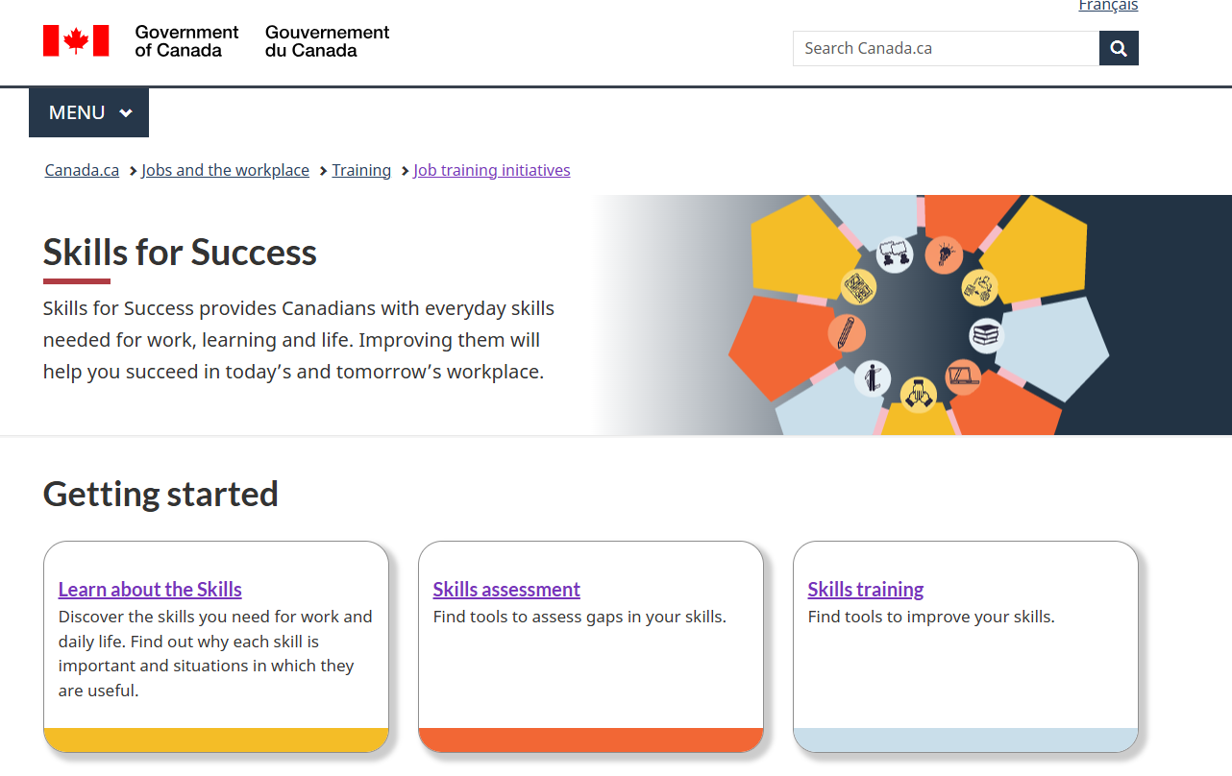
Skills for Success Website
p 34
Notes:
ROBINA
SFS Resources
Do
Refer participants to the resources on the following slides
Let them know they will find links in their participant materials and the microsite
Official SFS website
say
Here you’ll find links to all of the following tools…
https://www.canada.ca/en/services/jobs/training/initiatives/skills-success.html

Slide 46
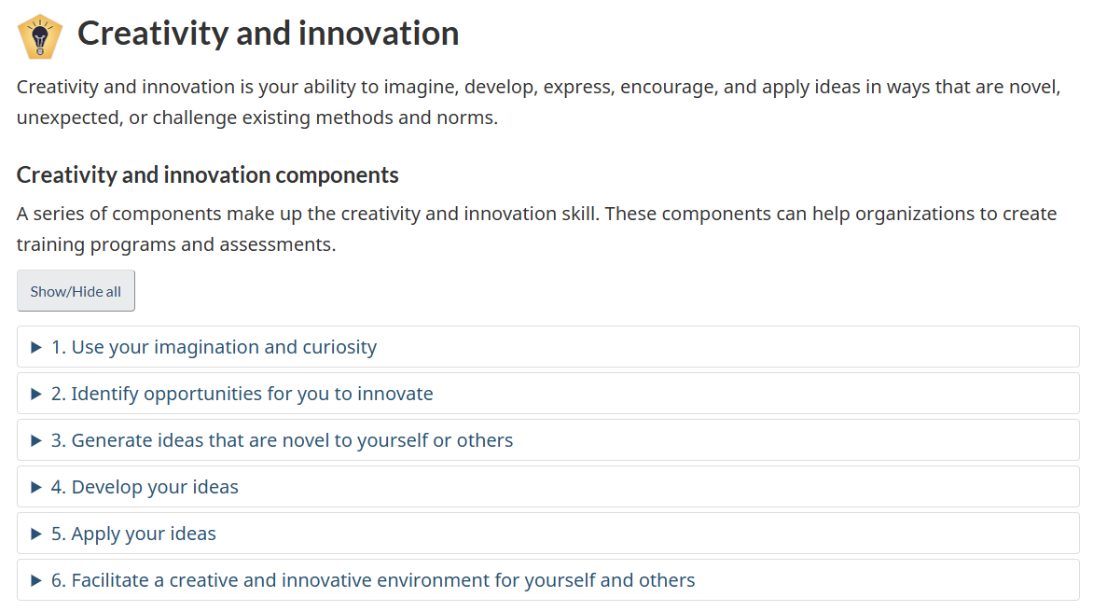
Skills for Success Skills and components
p 34
Notes:
ROBINA
Official SFS website
say
Here you’ll find the definitions, components and behaviours
https://www.canada.ca/en/services/jobs/training/initiatives/skills-success/learning-steps.html#creativity

Slide 47
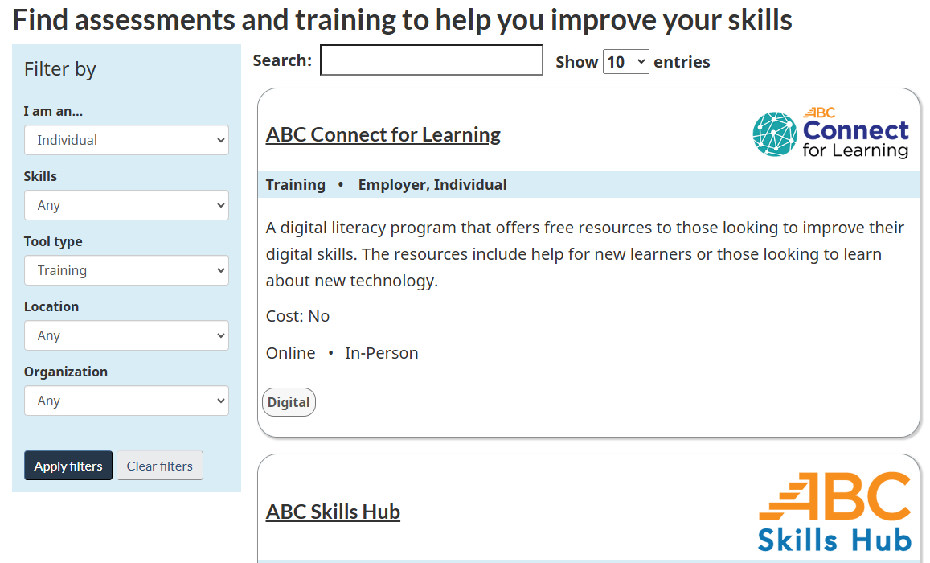
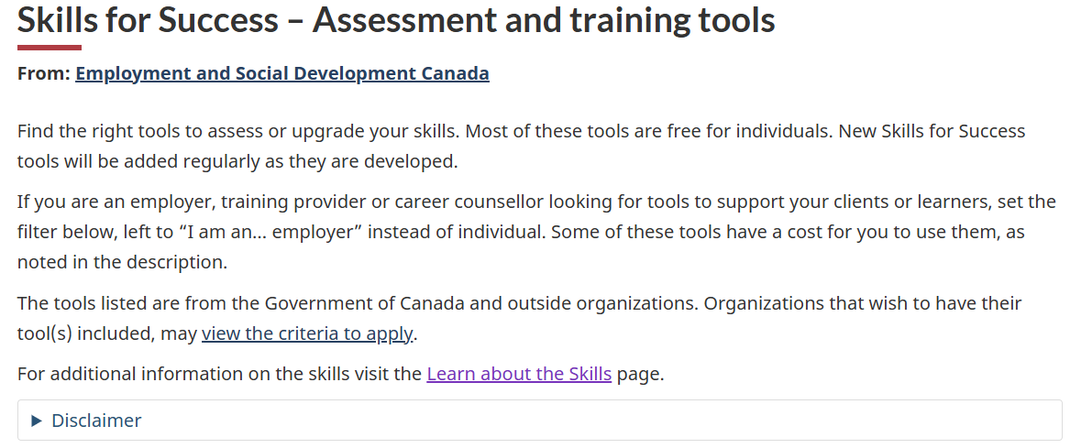
Skills for Success Assessment and training tools
p 34
Notes:
ROBINA
Official SFS website Assessment and training tools
say
Here is a searchable repository of various assessments, programs and resources approved by ESDC to support development
Includes both free and paid resources
Searchable:
As Individual or Employer
By specific skill or all skills
Training or assessments
Online or in-person, and
By specific organization or provider
https://www.canada.ca/en/services/jobs/training/initiatives/skills-success/tools.html?category=Individual&type=Training

Slide 48

Skills for Success Snapshot
p 34
Notes:
ROBINA
SFS Snapshot
say
This, for example is a self-assessment you and your learners can use AFTER completing a skill-building program
https://immplus.ca/snapshot/

Slide 49
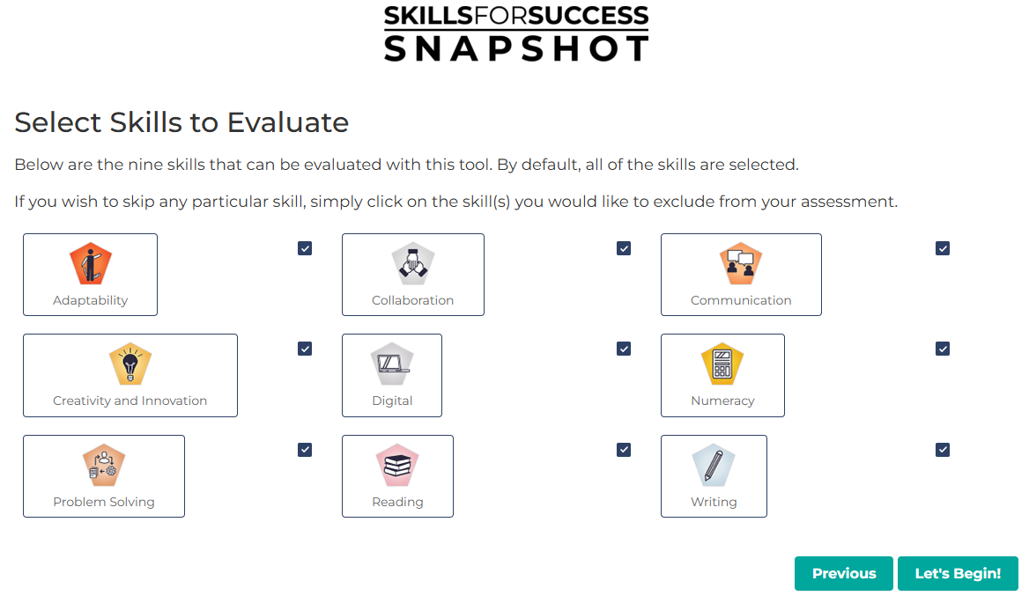
Skills for Success Snapshot
p 34
Notes:
ROBINA
SFS Snapshot
say
Learners can choose to do any or all of the skills
https://immplus.ca/snapshot/

Slide 50
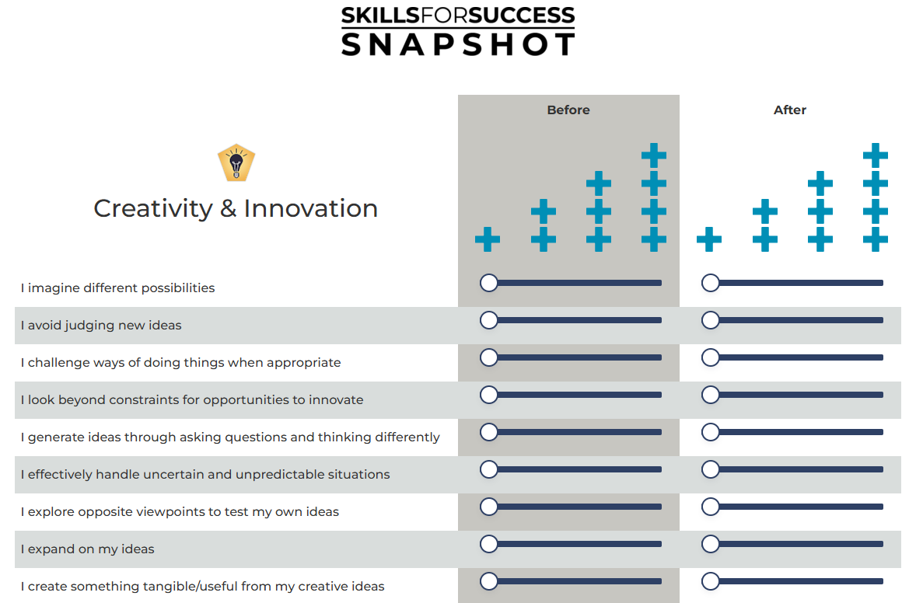
Skills for Success Snapshot
p 34
Notes:
ROBINA
SFS Snapshot
say
Here is a sneak peek of the creativity & innovation assessment
Learners rank against their perceived creativity & innovation BEFORE and AFTER the intervention
https://immplus.ca/snapshot/

Slide 51
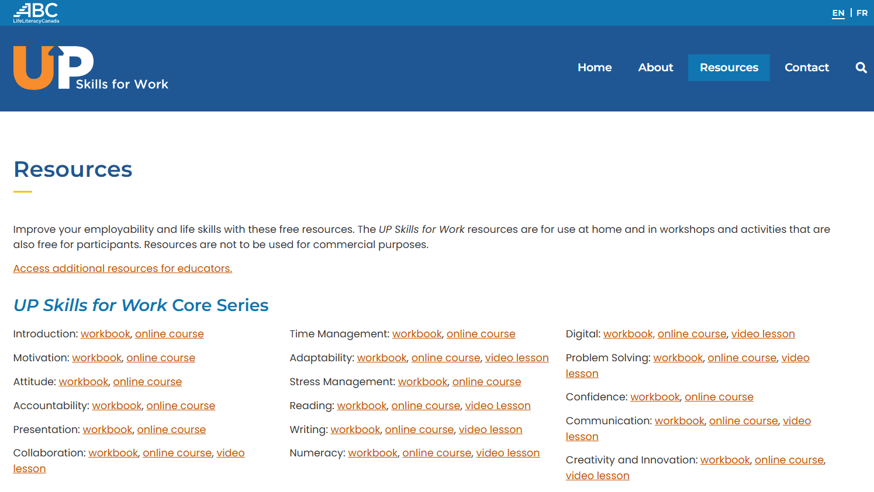
Skills for Success Resources
p 34
Notes:
ROBINA
UP Skills for Work website
Say
One example of resources available from one of the organizations hosted on the SFS search engine
https://upskillsforwork.ca/resources/

Slide 52
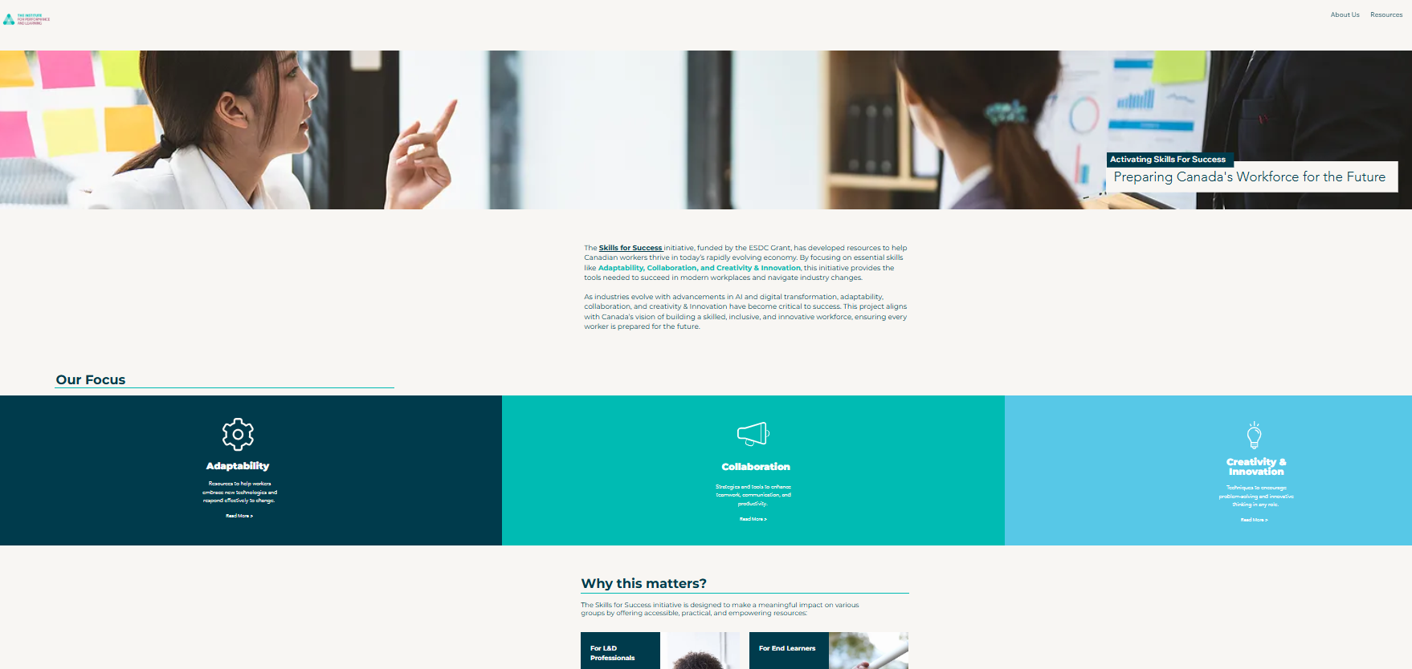
Skills for Success Resources
p 34
Notes:
ROBINA
I4PL Microsite
Say
This is where you will find the research article as well as the powerpoint versions of this presentation and the workbook for you to use for future programs
/
Transition to BEVERLY to explain about badges

Slide 53
Skills for success badges
Notes:
BEVERLY
Say
As part of this initiative, you were promised badges distinguishing you as Skills for Success Learning Providers

Slide 54


Two types of badges
For you
For your learners
p 36
Notes:
BEVERLY
Types of badges 1 min
Say
There are two types of badges available
[click] the first is the Learning Provider badge, which you are eligible for
[click] the second is available for you to provide to participants of the programs you implement to increase creativity & innovation
Let’s look more closely at each of them

Slide 55
Learning Provider badge
You can proudly post this badge and gain 8 continuing education credits for this program.
Two requirements:
  Participation in this workshop
  Completion of a small assignment detailing your implementation plan
p 36
Notes:
BEVERLY
Requirements 1 min
Do
Read through the points on the slide

Slide 56
Submitting your implementation plan
Visit CanCred to provide responses to the following:
  The greatest benefit my organization will enjoy as a result of improved creativity & innovation is…
  Our most significant organizational barriers to developing creativity & innovation are…
  The organizational structures we need to address to support creativity & innovation are…
  My plan for increasing creativity & innovation in my organization
    PDF file upload
    Be sure to identify approaches for development at various levels
p 36
Notes:
BEVERLY
Submitting your implementation plan 2 min
Do
Read through the points on the slide
CanCred
Transition to ROBINA to discuss the LEARNER badges

Slide 57
Issuing badges to your learners
The programs you implement should ensure learners are able to:
  Articulate the benefits of creativity & innovation for their team, the organization and themselves
  Identify individual barriers to developing creativity & innovation
  Determine what is needed to support creativity & innovation
  Develop strategies for being more creative & innovative in various situations
p 37
Notes:
ROBINA
Suggestions for learner programs 2 min
Do
Read through the points on the slide

Slide 58
Issuing badges to your learners
Suggested learning experiences include:
  An interactive workshop which provides:
    Key concepts and applications for the workplace
    Practical activities to apply the concepts in real-life scenarios
    Opportunities to work with others in the development of the skill
  Follow up activities that enable learners to apply the skill with support from their manager
  Submission of a personal action plan
p 37
Notes:
ROBINA
Suggestions for learner programs 2 min
Do
Read through the points on the slide

Slide 59
Issuing badges to learners
Direct learners to CanCred using the access code: wsnbiayxx5wa
  Learners apply for their badges by providing their name and responses to the following:
    My most significant barriers to developing creativity & innovation are…
    My #1 strategy for being more creative & innovative is…
p 37
Notes:
ROBINA
Learner badge requirements 2 min
Do
Read through the points on the slide
Point out they need to provide the instructions to their learners
Transition to BEVERLY to lead the closing activity

Slide 60
Closing the day
Notes:
BEVERLY

Slide 61
Committing to creativity & innovation
Virtual baton
What is one thing you will do differently
after today?
p 38
Notes:
BEVERLY
Lead closing activity 8 min
DO
Explain we will use a virtual baton
You will nominate one person and ask them to share ONE thing they will do differently after today
Then they should nominate someone else, until some participants have shared
You will be last
Remind them to put together their implementation plan and apply for their badges
Transition- Robina
Ask for questions and thank participants

Slide 62
Questions?
Thank you from all of us at I4PL
Notes:
Robina

